Slide 1
DSC640 Weekly Assignment
Week 9 & 10
Edris Safari

Slide 2
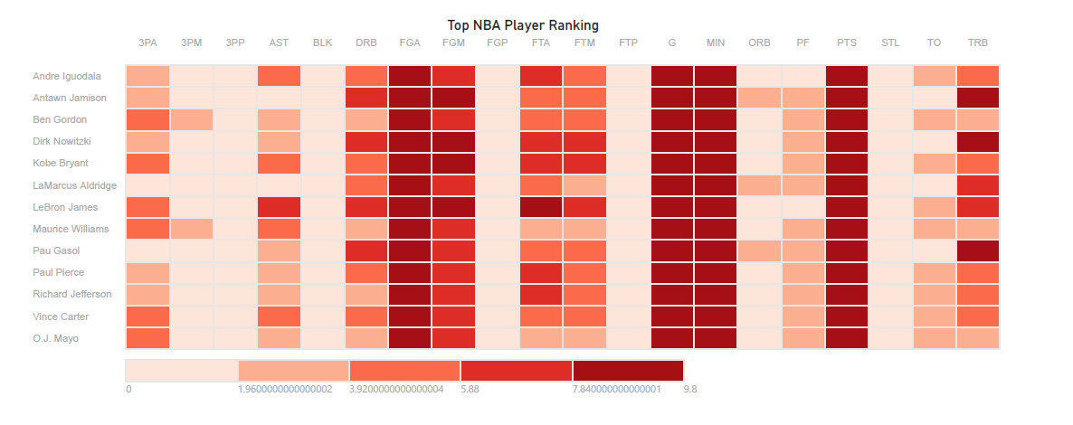
PowerBI Heatmap

Slide 3
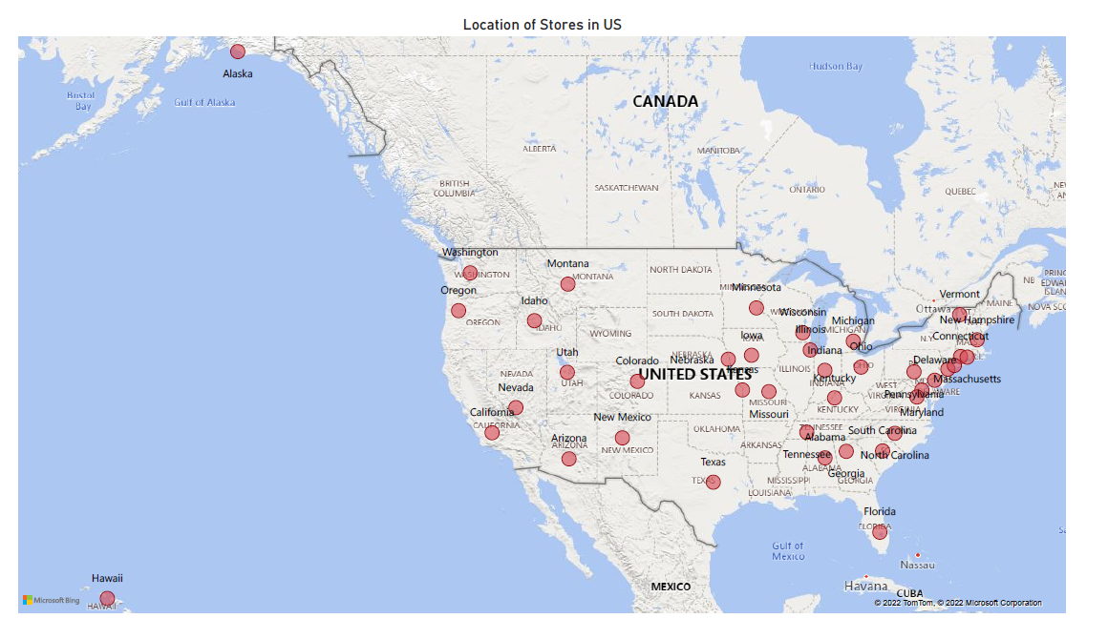
PowerBI Spatial

Slide 4
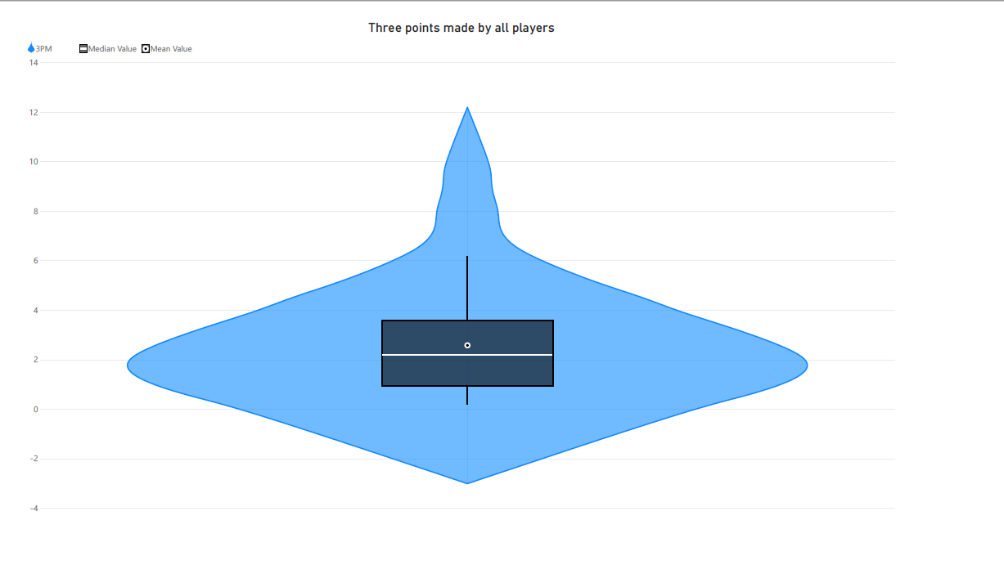
PowerBI Violin

Slide 5
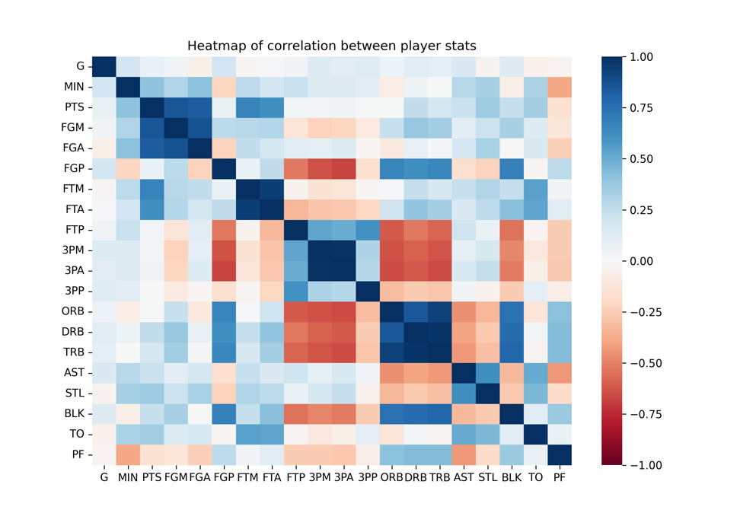
Python Heatmap

Slide 6
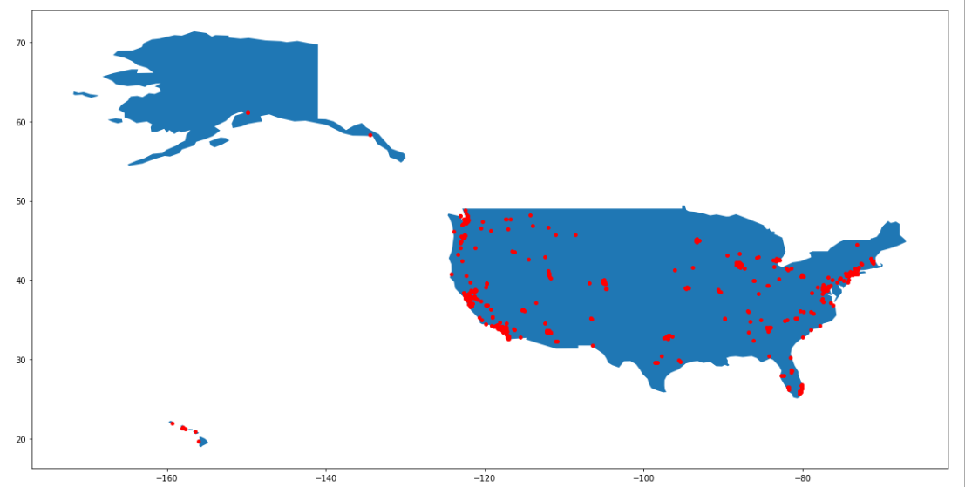
Python Spatial

Slide 7
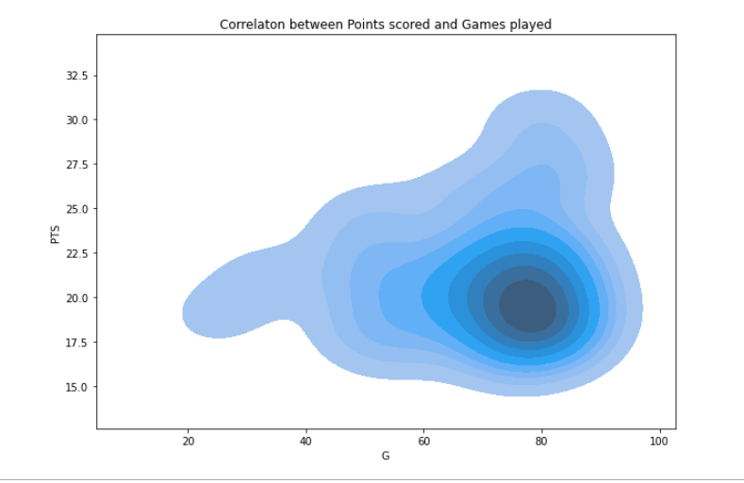
Python Contour

Slide 8
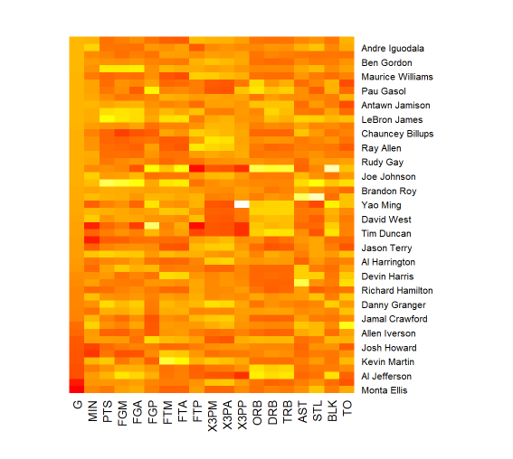
R Heatmap

Slide 9
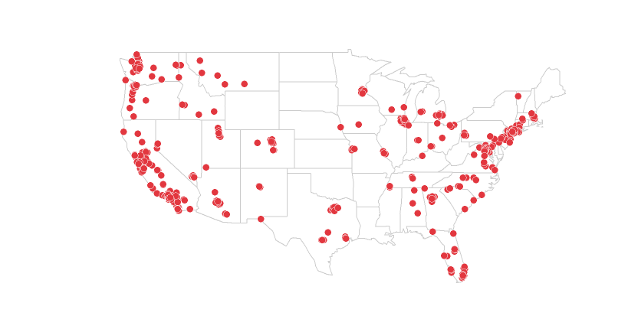
R Spatial

Slide 10
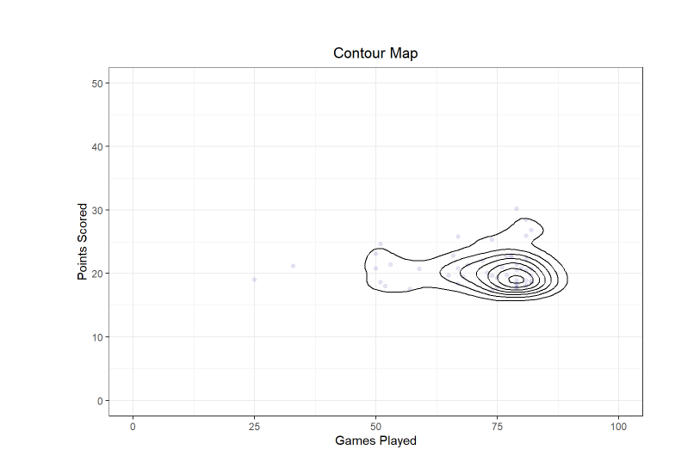
R Contour

